Slide 1
Neural Networks cont.
Keith Burghardt, Kristina Lerman
USC Information Sciences Institute
DSCI 552 – Spring 2021

Slide 2
Topics this week
Reminder:
Quiz 4 due Wednesday
Neural network models
Convolutional neural networks(CNN).
Batch normalization
Model architectures:
LeNet
AlexNet
VGG
ResNet
Symmetries and Invariance
Variational Autoencoder

Slide 3
Discussion of Quiz 4 Answers

Slide 4
Architectures

Slide 5
Common Architectures
1989: LeNet
first time CNN was used
Inspired by “neocognitron” (looking at local features)
2012: AlexNet (game changer: top-5 accuracy = 15%, 10 points better than runner up!)
VGG
ResNet
All the work is hyperparameter tuning:
Filters
kernel_size (how large a patch)
Strides (how much you move in x,y direction)
…

Slide 6
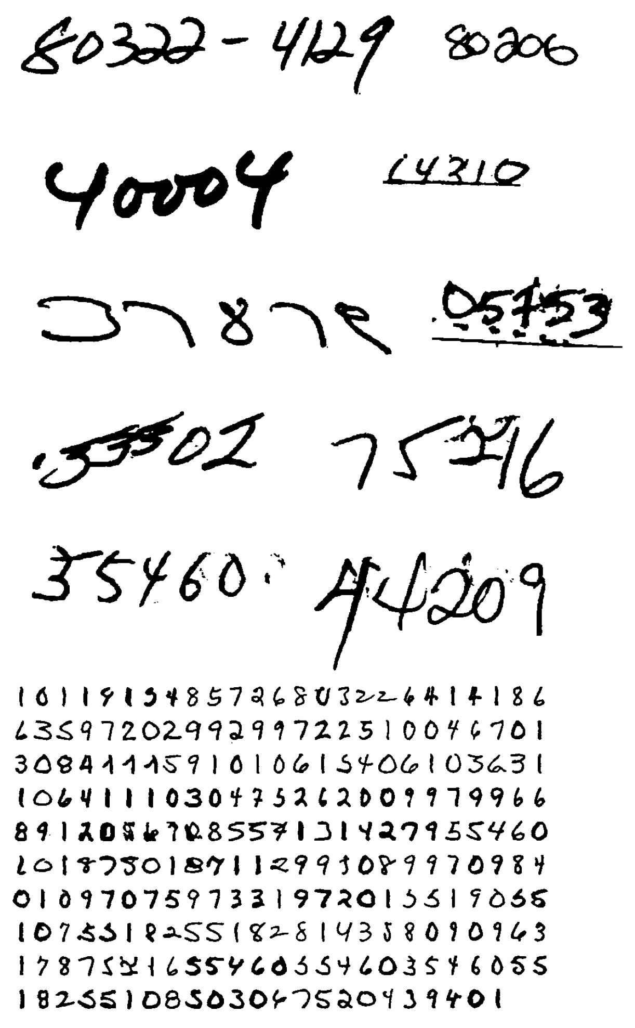
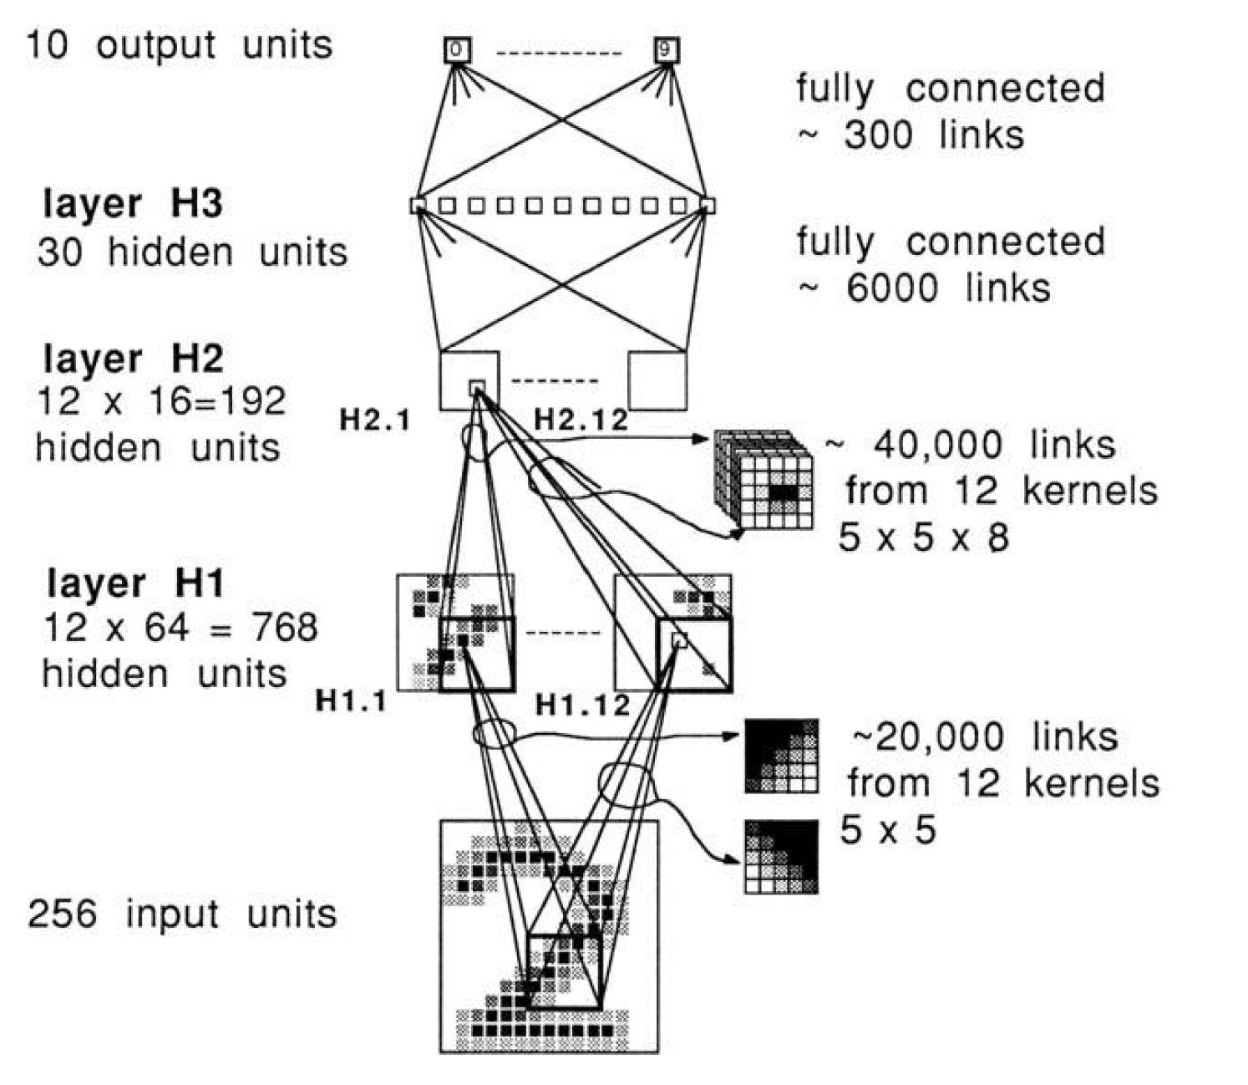
LeNet: Just a Regular ConvNet
LeCun et al., 1989
Activation function: Tanh

Slide 7
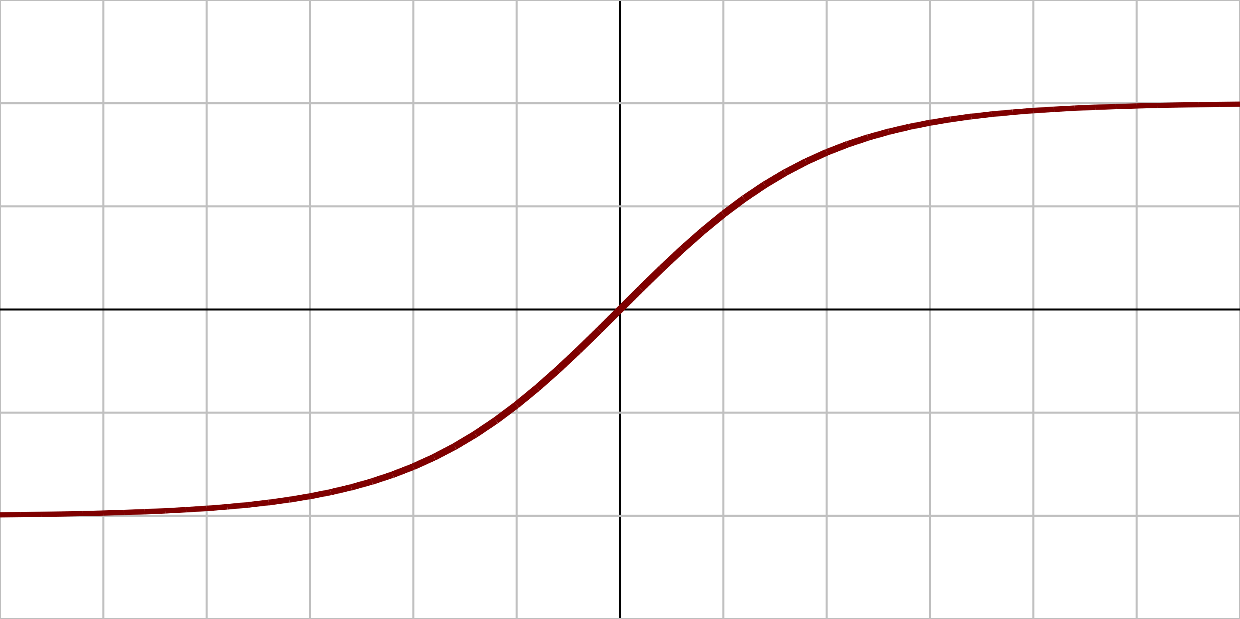
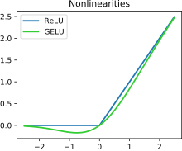
AlexNet
Benchmark: 15M data, 22,000 categories
Deeper GPU-based network
8 layers
Faster training
Activation function is ReLU (now the standard)
“Rectifier linear unit”
F(x) = x if x>0, else 0
Deep NNs with ReLU are proven to universally approximate continuous function
Old: Tanh
Current: ReLU (and similar)
https://en.wikipedia.org/wiki/Activation_function

Slide 8
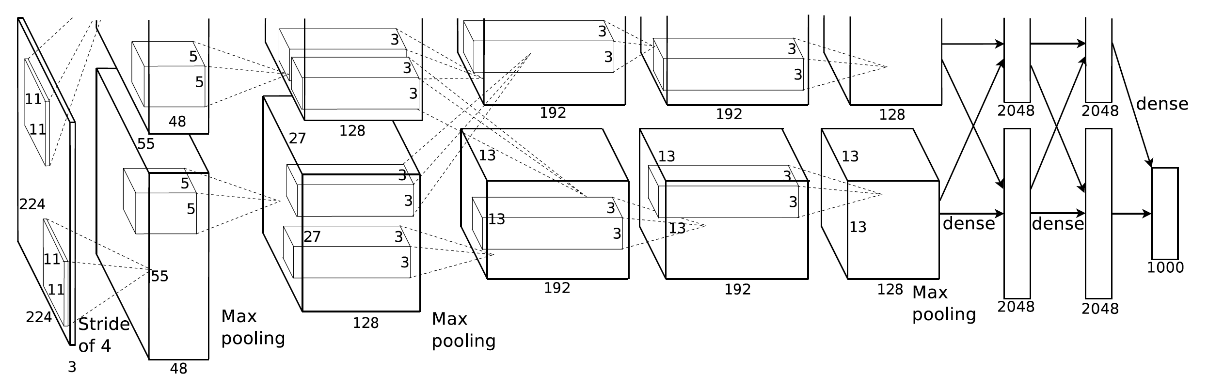
AlexNet
Training is split between GPUs with minimal communication at each layer
Final dense layer combines inputs for better accuracy

Slide 9

VGG16

Slide 10
VGG16
16 Convolution layers
Very slow to train!
Luckily we can use pre-trained models and fine tune
Output: raw data is between –infinity and infinity (usually between -10^16 and 10^16)
To achieve “confidence” we use softmax: R-> R in (0,1)
I.e., we get values between 0 and 1 that say something about how sure the network is that the data is “1,” “2,” etc.,

Slide 11
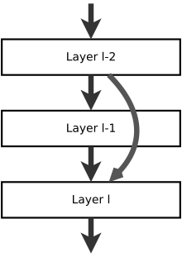
ResNet
“Residual neural network”
If layer I-2 and layer I have the same number of neurons, information is transformed/lost at layer I-1
This network allows features to propagate across layers
Avoids vanishing gradients
https://en.wikipedia.org/wiki/Residual_neural_network

Slide 12
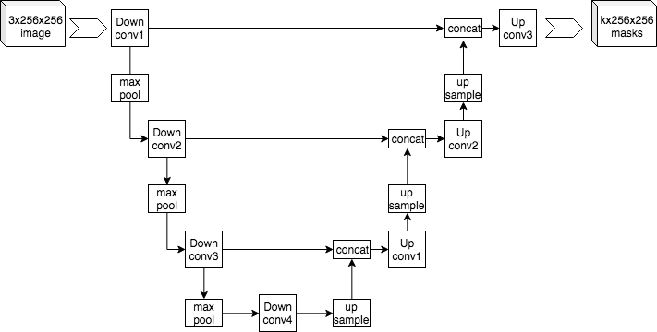
U-Net
Note the “U” shape
How to make these “jumps” on Keras
Layer(input)
Features propagate, like ResNet
Compressed information is here

Slide 13
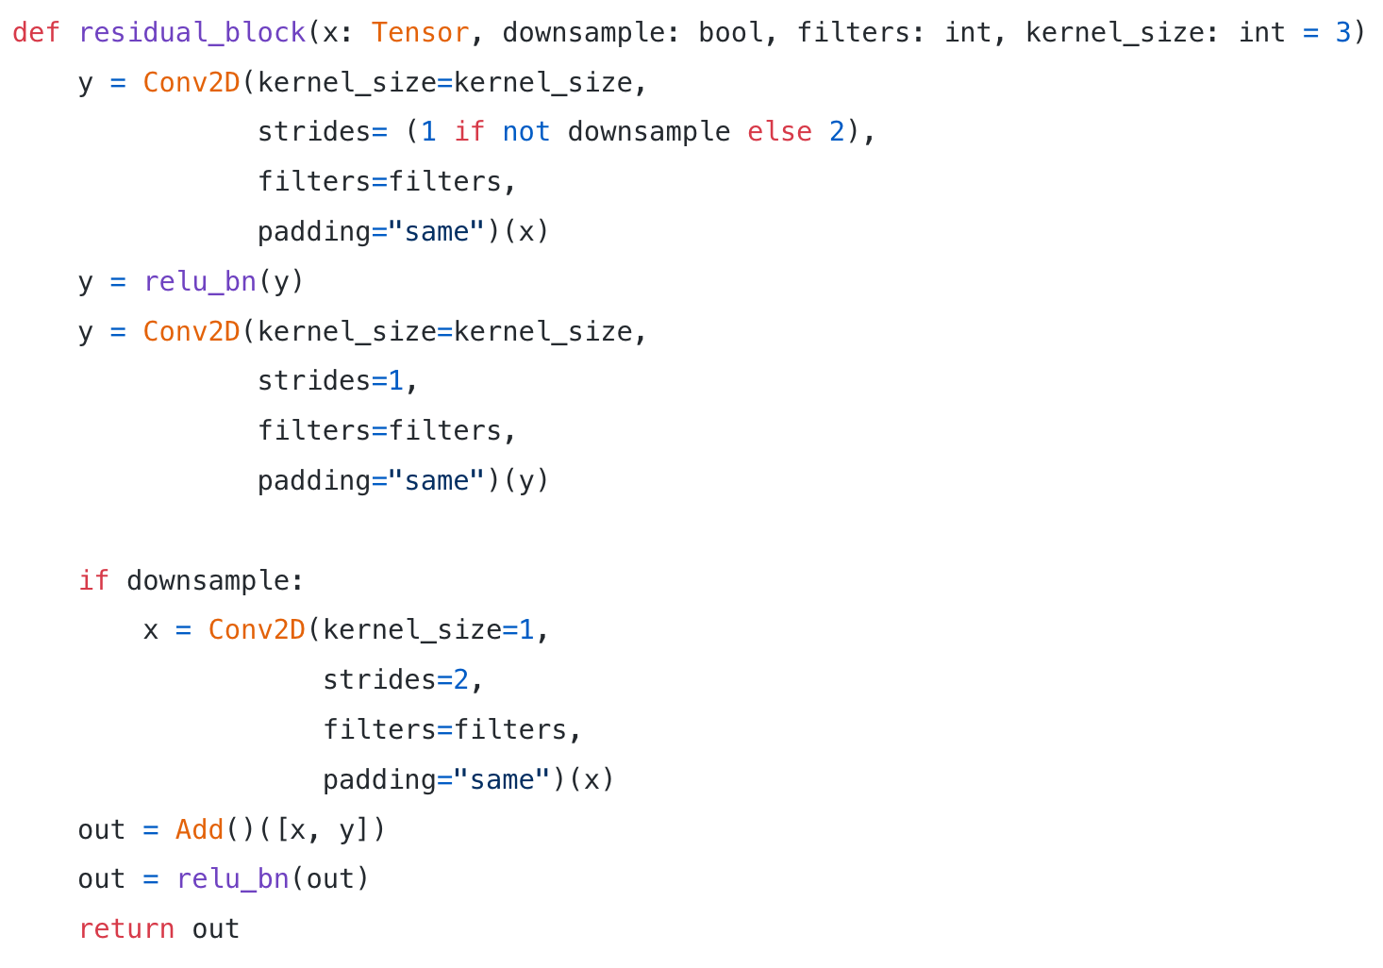
Code Example
https://towardsdatascience.com/building-a-resnet-in-keras-e8f1322a49ba

Slide 14
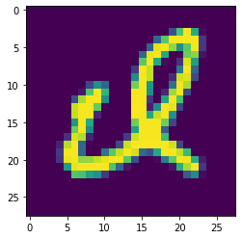
Symmetries and Invariance
Neural networks are fragile
They do not work well outside of their trained data
Example: even rotating/flipping images
Test (regular images): accuracy = 98.6%
Test (flipped, rotated images): accuracy = 16%

Slide 15
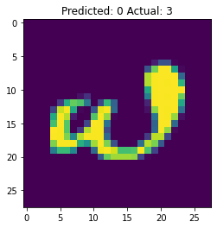
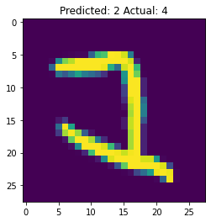
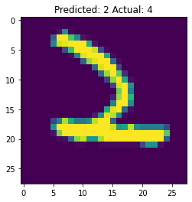
Confidence is not probability!
Confidence = 0.8
Confidence = 0.7
Confidence = 0.9997

Slide 16
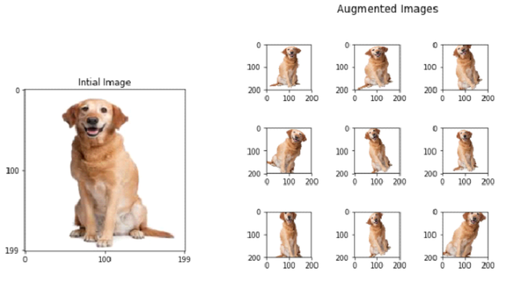
Solution 1: Augmentation
Train on both regular images and flipped/rotated images
Advantages:
Fast
More training data (more robust model)
https://towardsdatascience.com/translational-invariance-vs-translational-equivariance-f9fbc8fca63a

Slide 17
Caveats
Numerous ways to augment
Zooming (small and large “2”s should be correctly labeled)
Rotation
Flipping
…
=> Might miss special cases
Too much generalization hurts your model
A rotated 2 may look like a “4”, which will confuse your model
If your digits, faces, etc., will be correctly oriented, this method may needlessly add to training time, and might harm accuracy

Slide 18
Solution 2: Equivariance
Goal: preserve symmetries in networks
Equivariant: f(g . x) = g . f(x) (commute function without change)
Invariant f(g.x) = f(x) (unaffected by, e.g., rotation)
A face is still a face when rotated, flipped, etc.
I.e., it is “invariant” to these actions
If we want to remember the angle, the actions are “equivariant”
Bao and Song, “Equivariant Neural Networks and Equivarification” were one of the major drivers of this method
General tool to know both label and angles

Slide 19
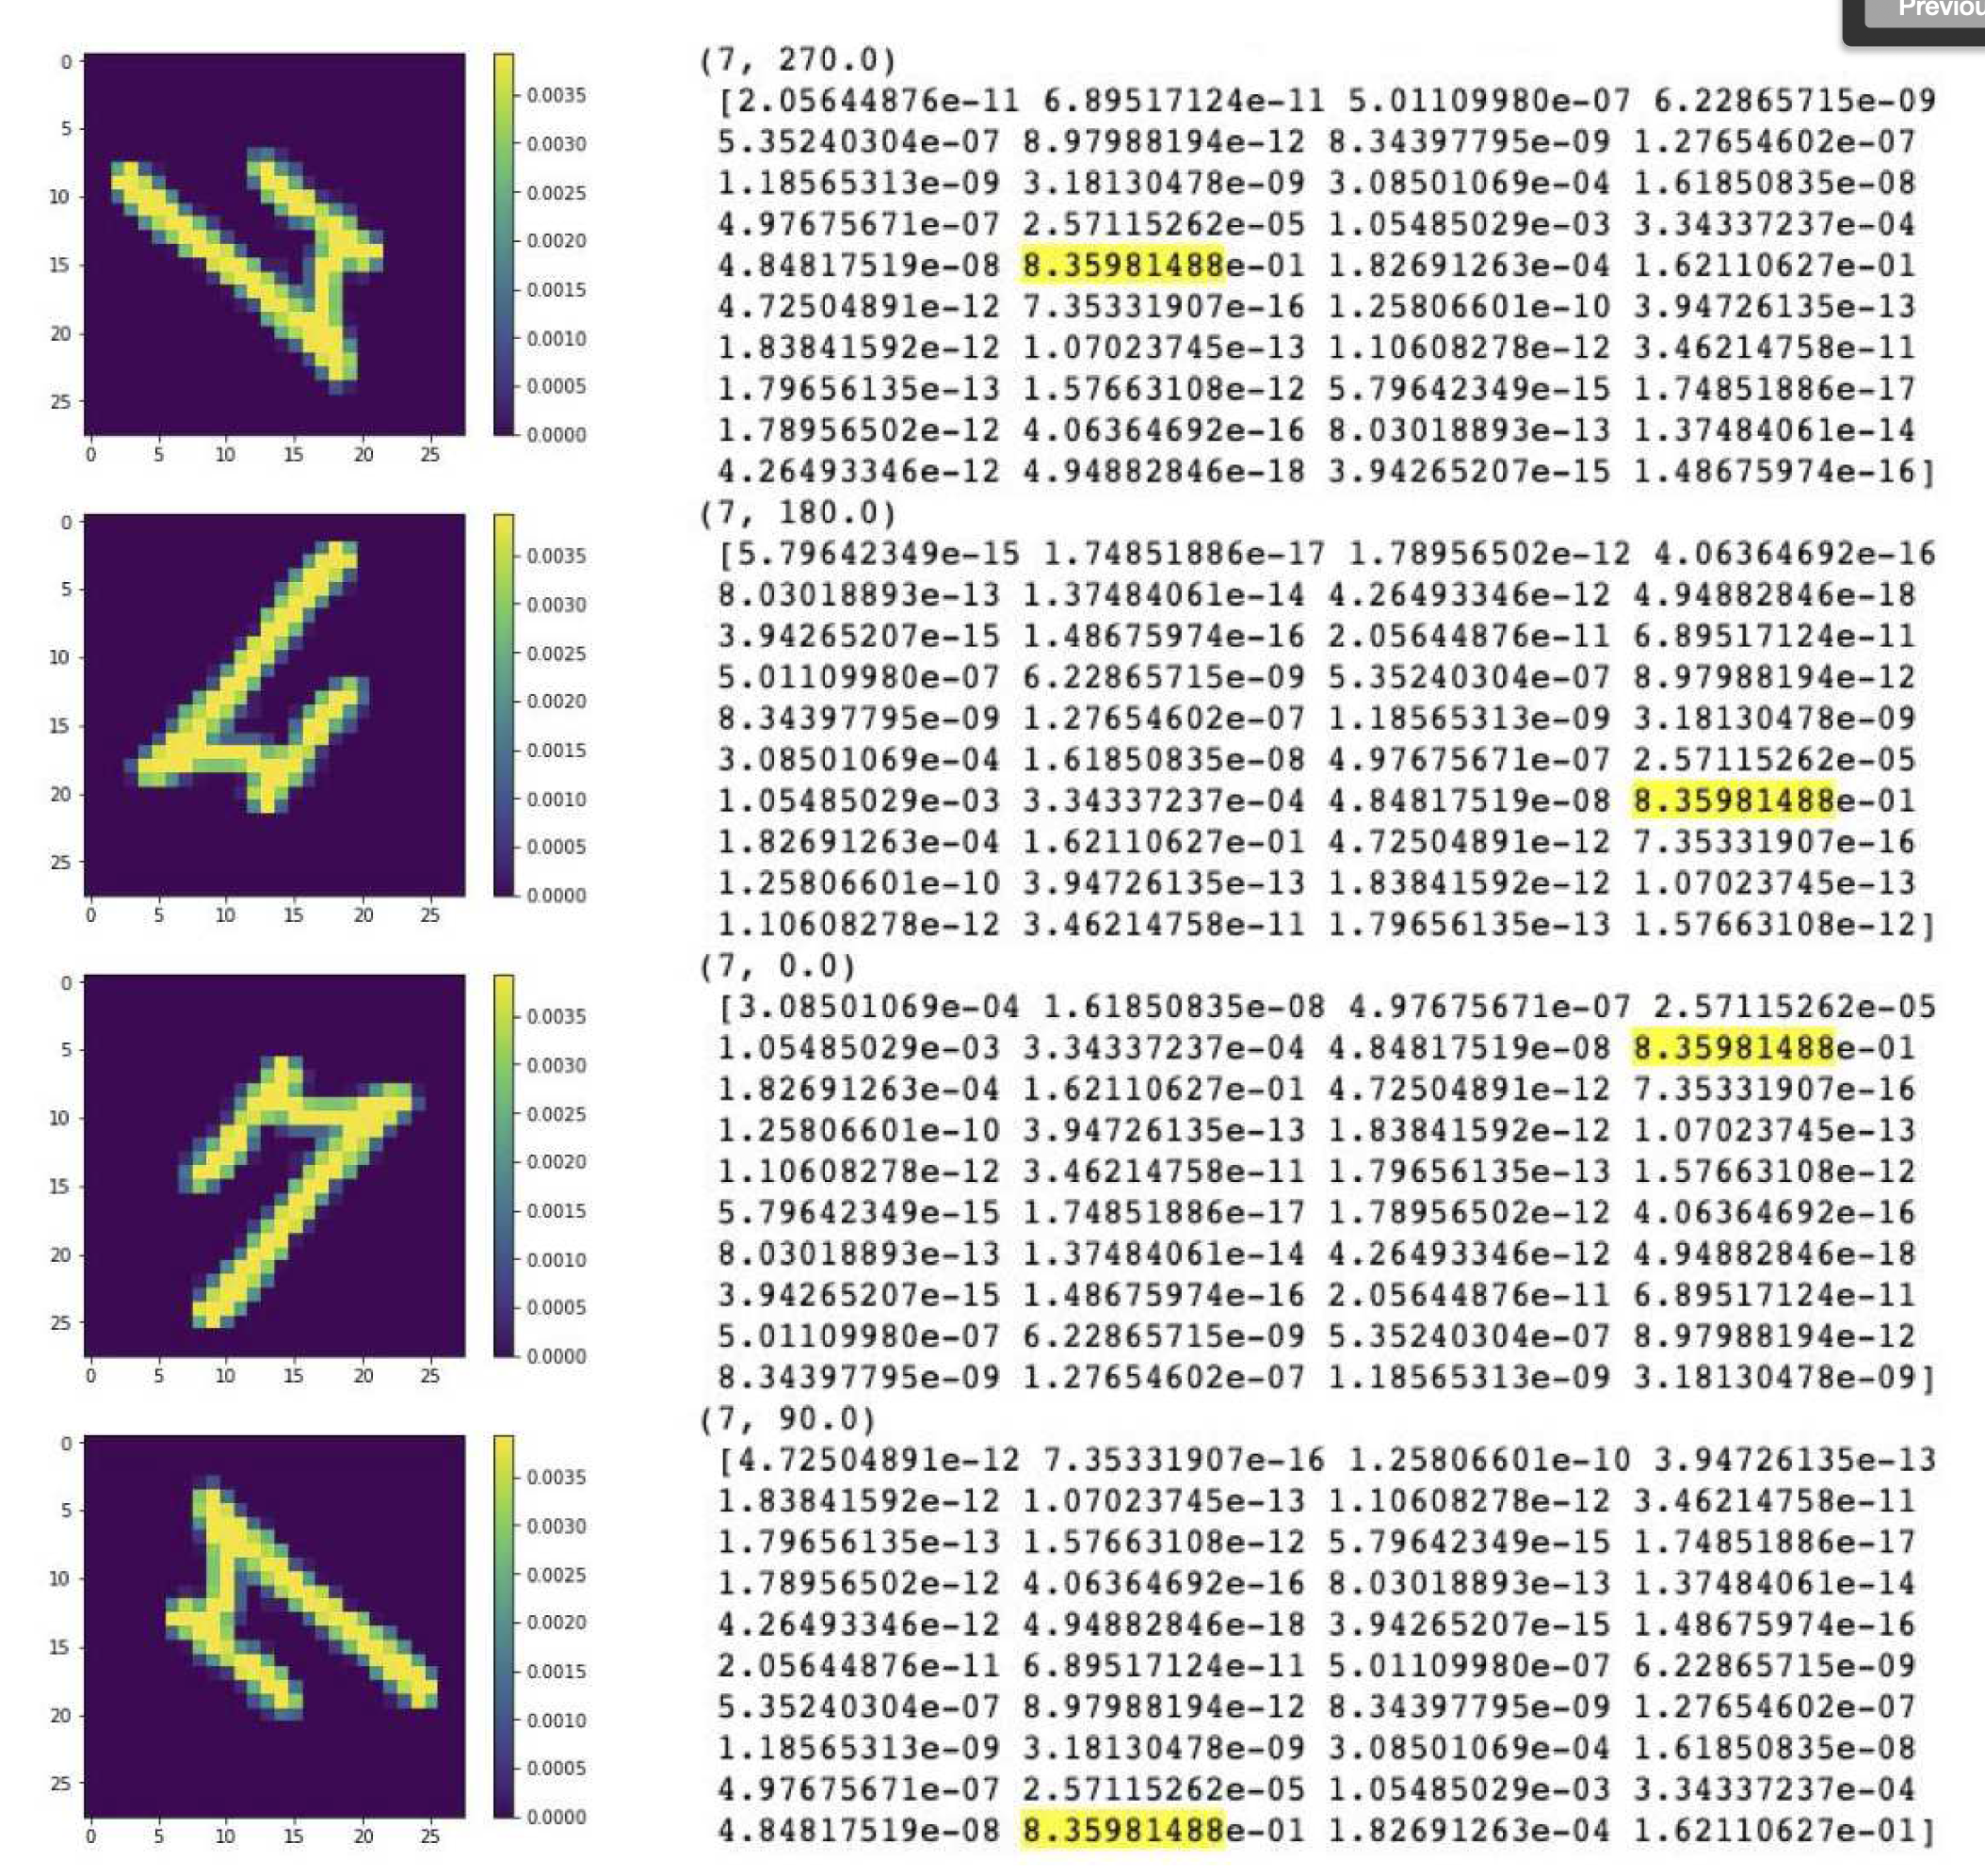
96.8% Accuracy:
both number AND angle
Bao and Song (2019)

Slide 20
Is a CNN Invariant to Translation?
Not quite: equivariant
As long as image is not cut off, the features are same, just in a slightly different part of layer
Therefore same features as well as image shift is preserved
Therefore, kernel is naturally equivariant to shifts
But…
Flattening vector => features may be in different parts of vector space
Final dense layer(s) could affect results
Therefore, for the most part, you only need to care about: zooming, flipping, rotation

Slide 21
Latest work and limitations
Wang, Walters, and Yu [From USC!]. “Incorporating Symmetry into Deep Dynamics Models for Improved Generalization” (2020)
Goal: make predictions in simulations that are robust to changes in
Magnitude (e.g., image dimming)
Rotation
Scaling (the same image but larger/smaller)
Develop kernels (filters) that do not depend on symmetries (rotations, etc)

Slide 22
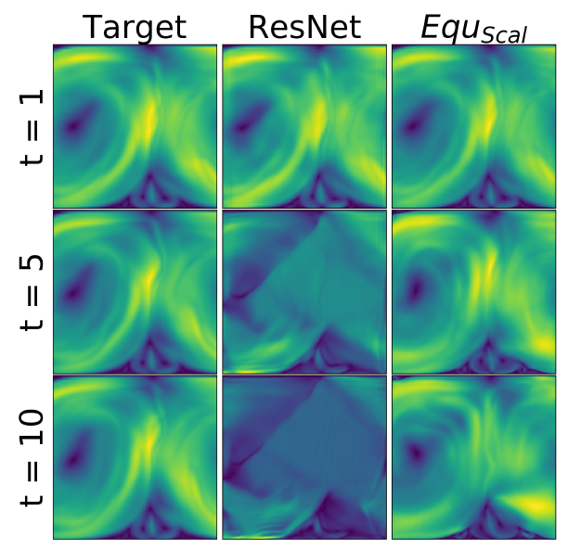
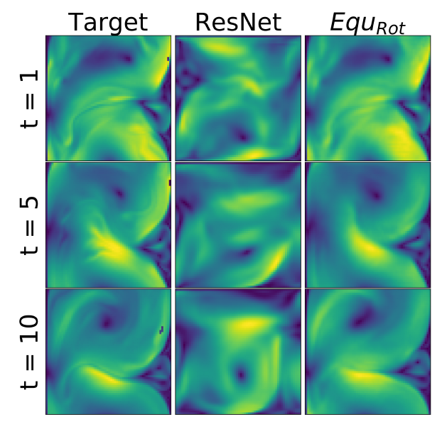
How well it works in practice
Scale-equivariant
Rotation-equivariant

Slide 23
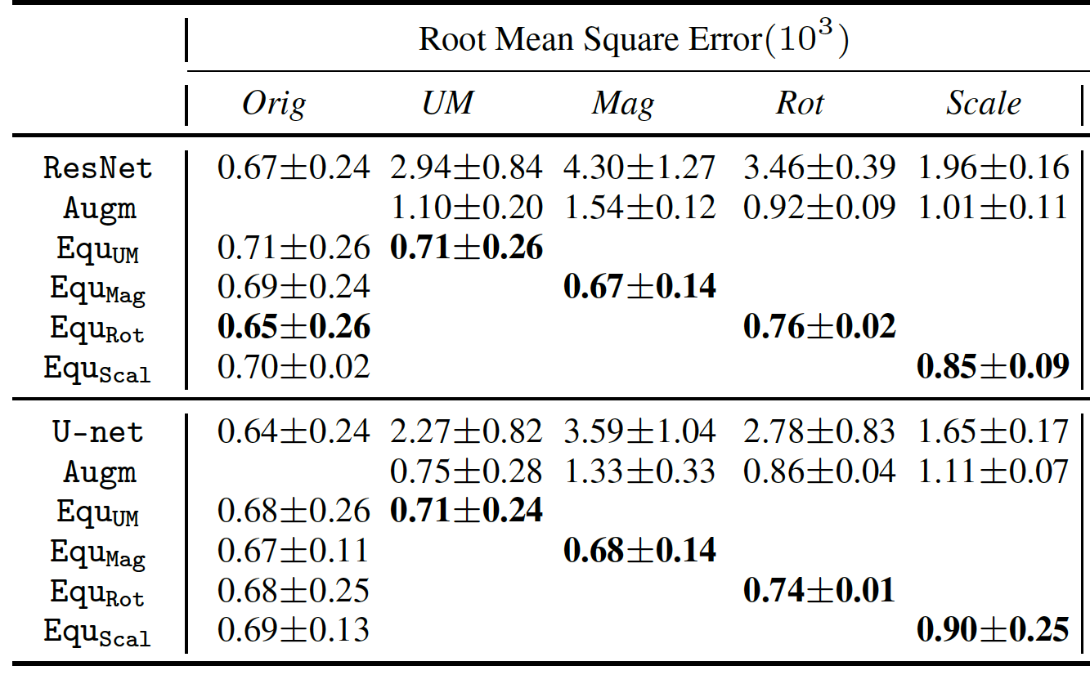
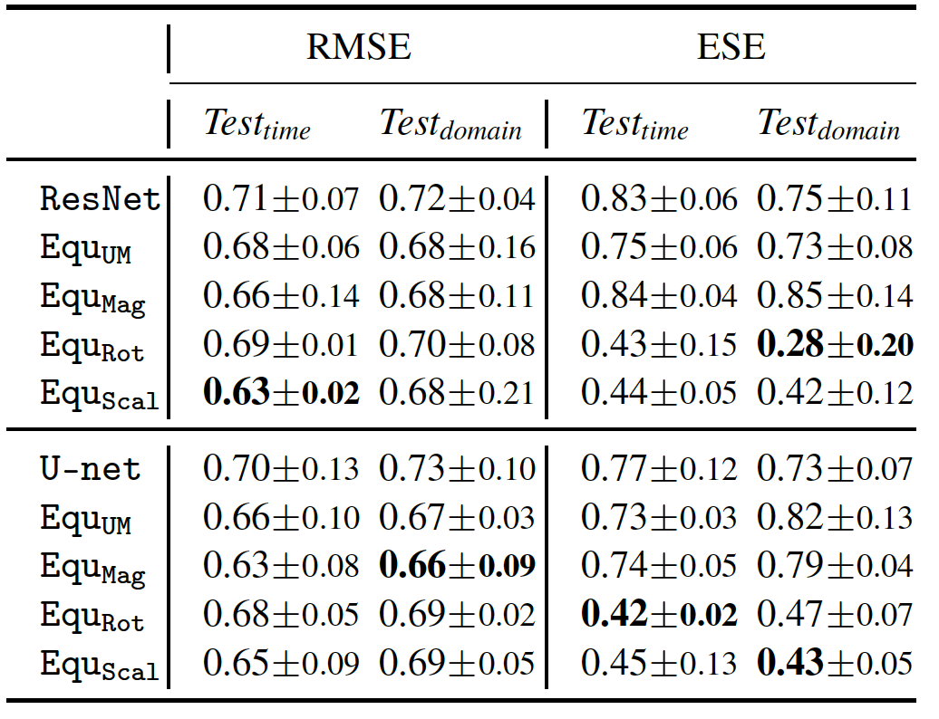
How Well It Works
…But is about as good in without rotation, scaling, etc.
(left columns)
New method works better than competition

Slide 24
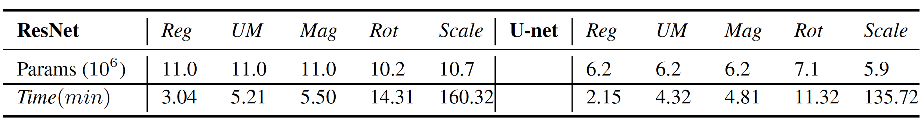
Limitations
While it works really well on each respective symmetry, it does not work on simultaneous symmetries
Very slow to train
On original data, regular ResNet/U-Net works almost as well

Slide 25
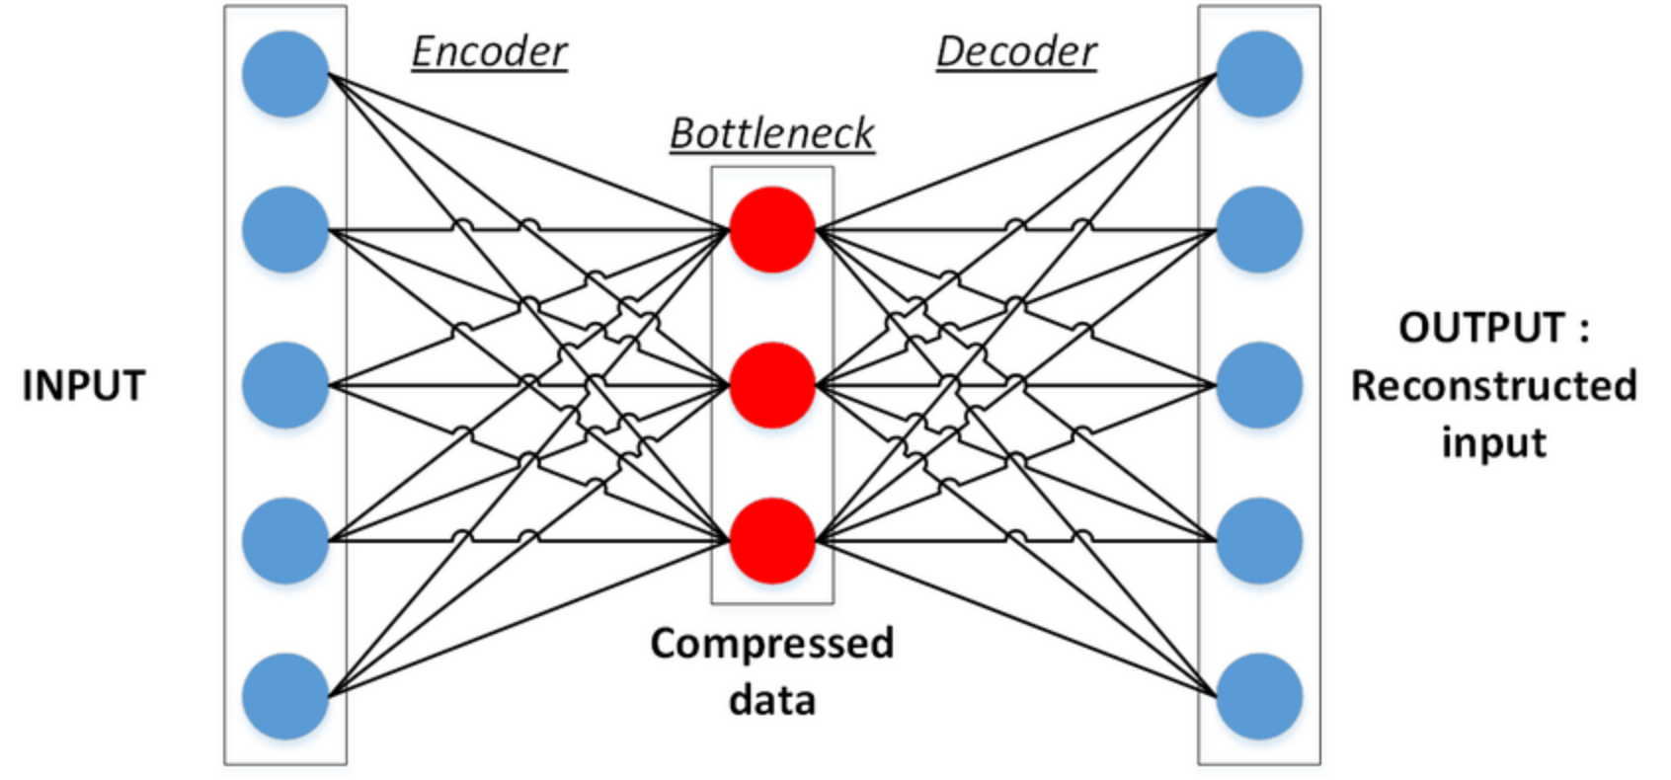
Fun with Architectures: Autoencoders
https://stackabuse.com/autoencoders-for-image-reconstruction-in-python-and-keras/

Slide 26
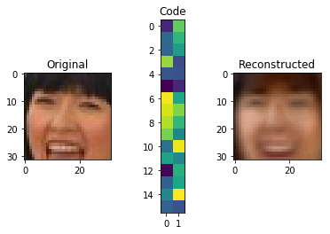
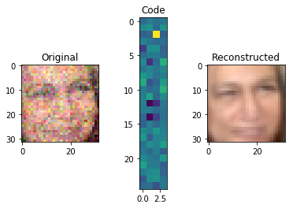
Example applications
Image (Encoder) -> “code” -> (Decoder) = image
Image (Encoder) -> “code” -> (Decoder) = image

Slide 27
Autoencoders
Useful for
Image reconstruction: X => X
Image “translation”: X => Y
What we mean by translation
Segmenting images into, e.g., objects, background, etc.
Turning images from one type of image into another
This is alike to Generative Adversarial Networks, as we will explain later

Slide 28
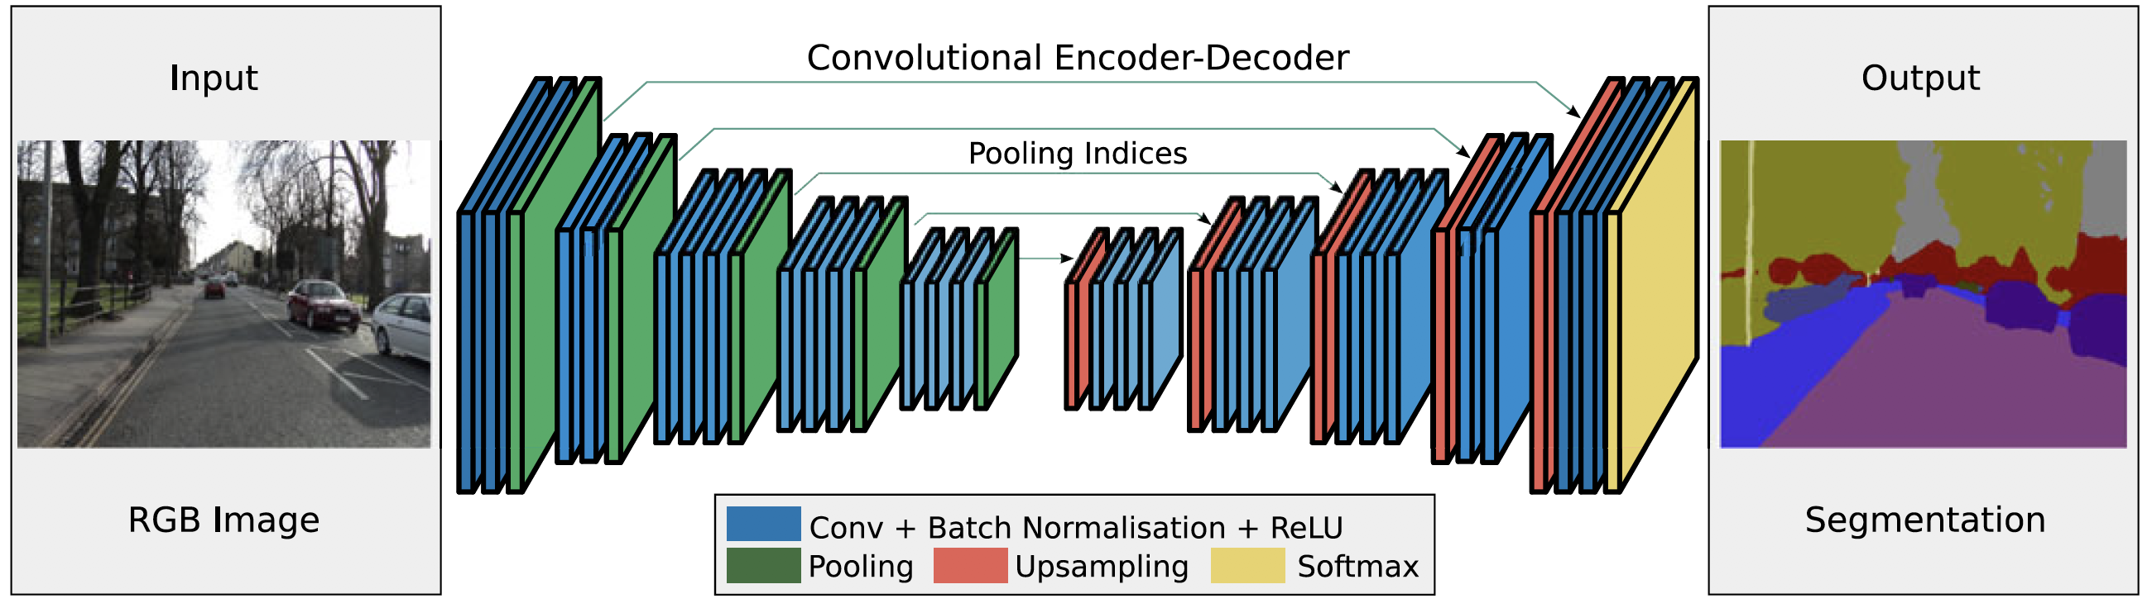
SegNet
13 CNN layers of VGG16
Novel layers
Badrinarayanan, Kendall , and Cipolla (2017)

Slide 29
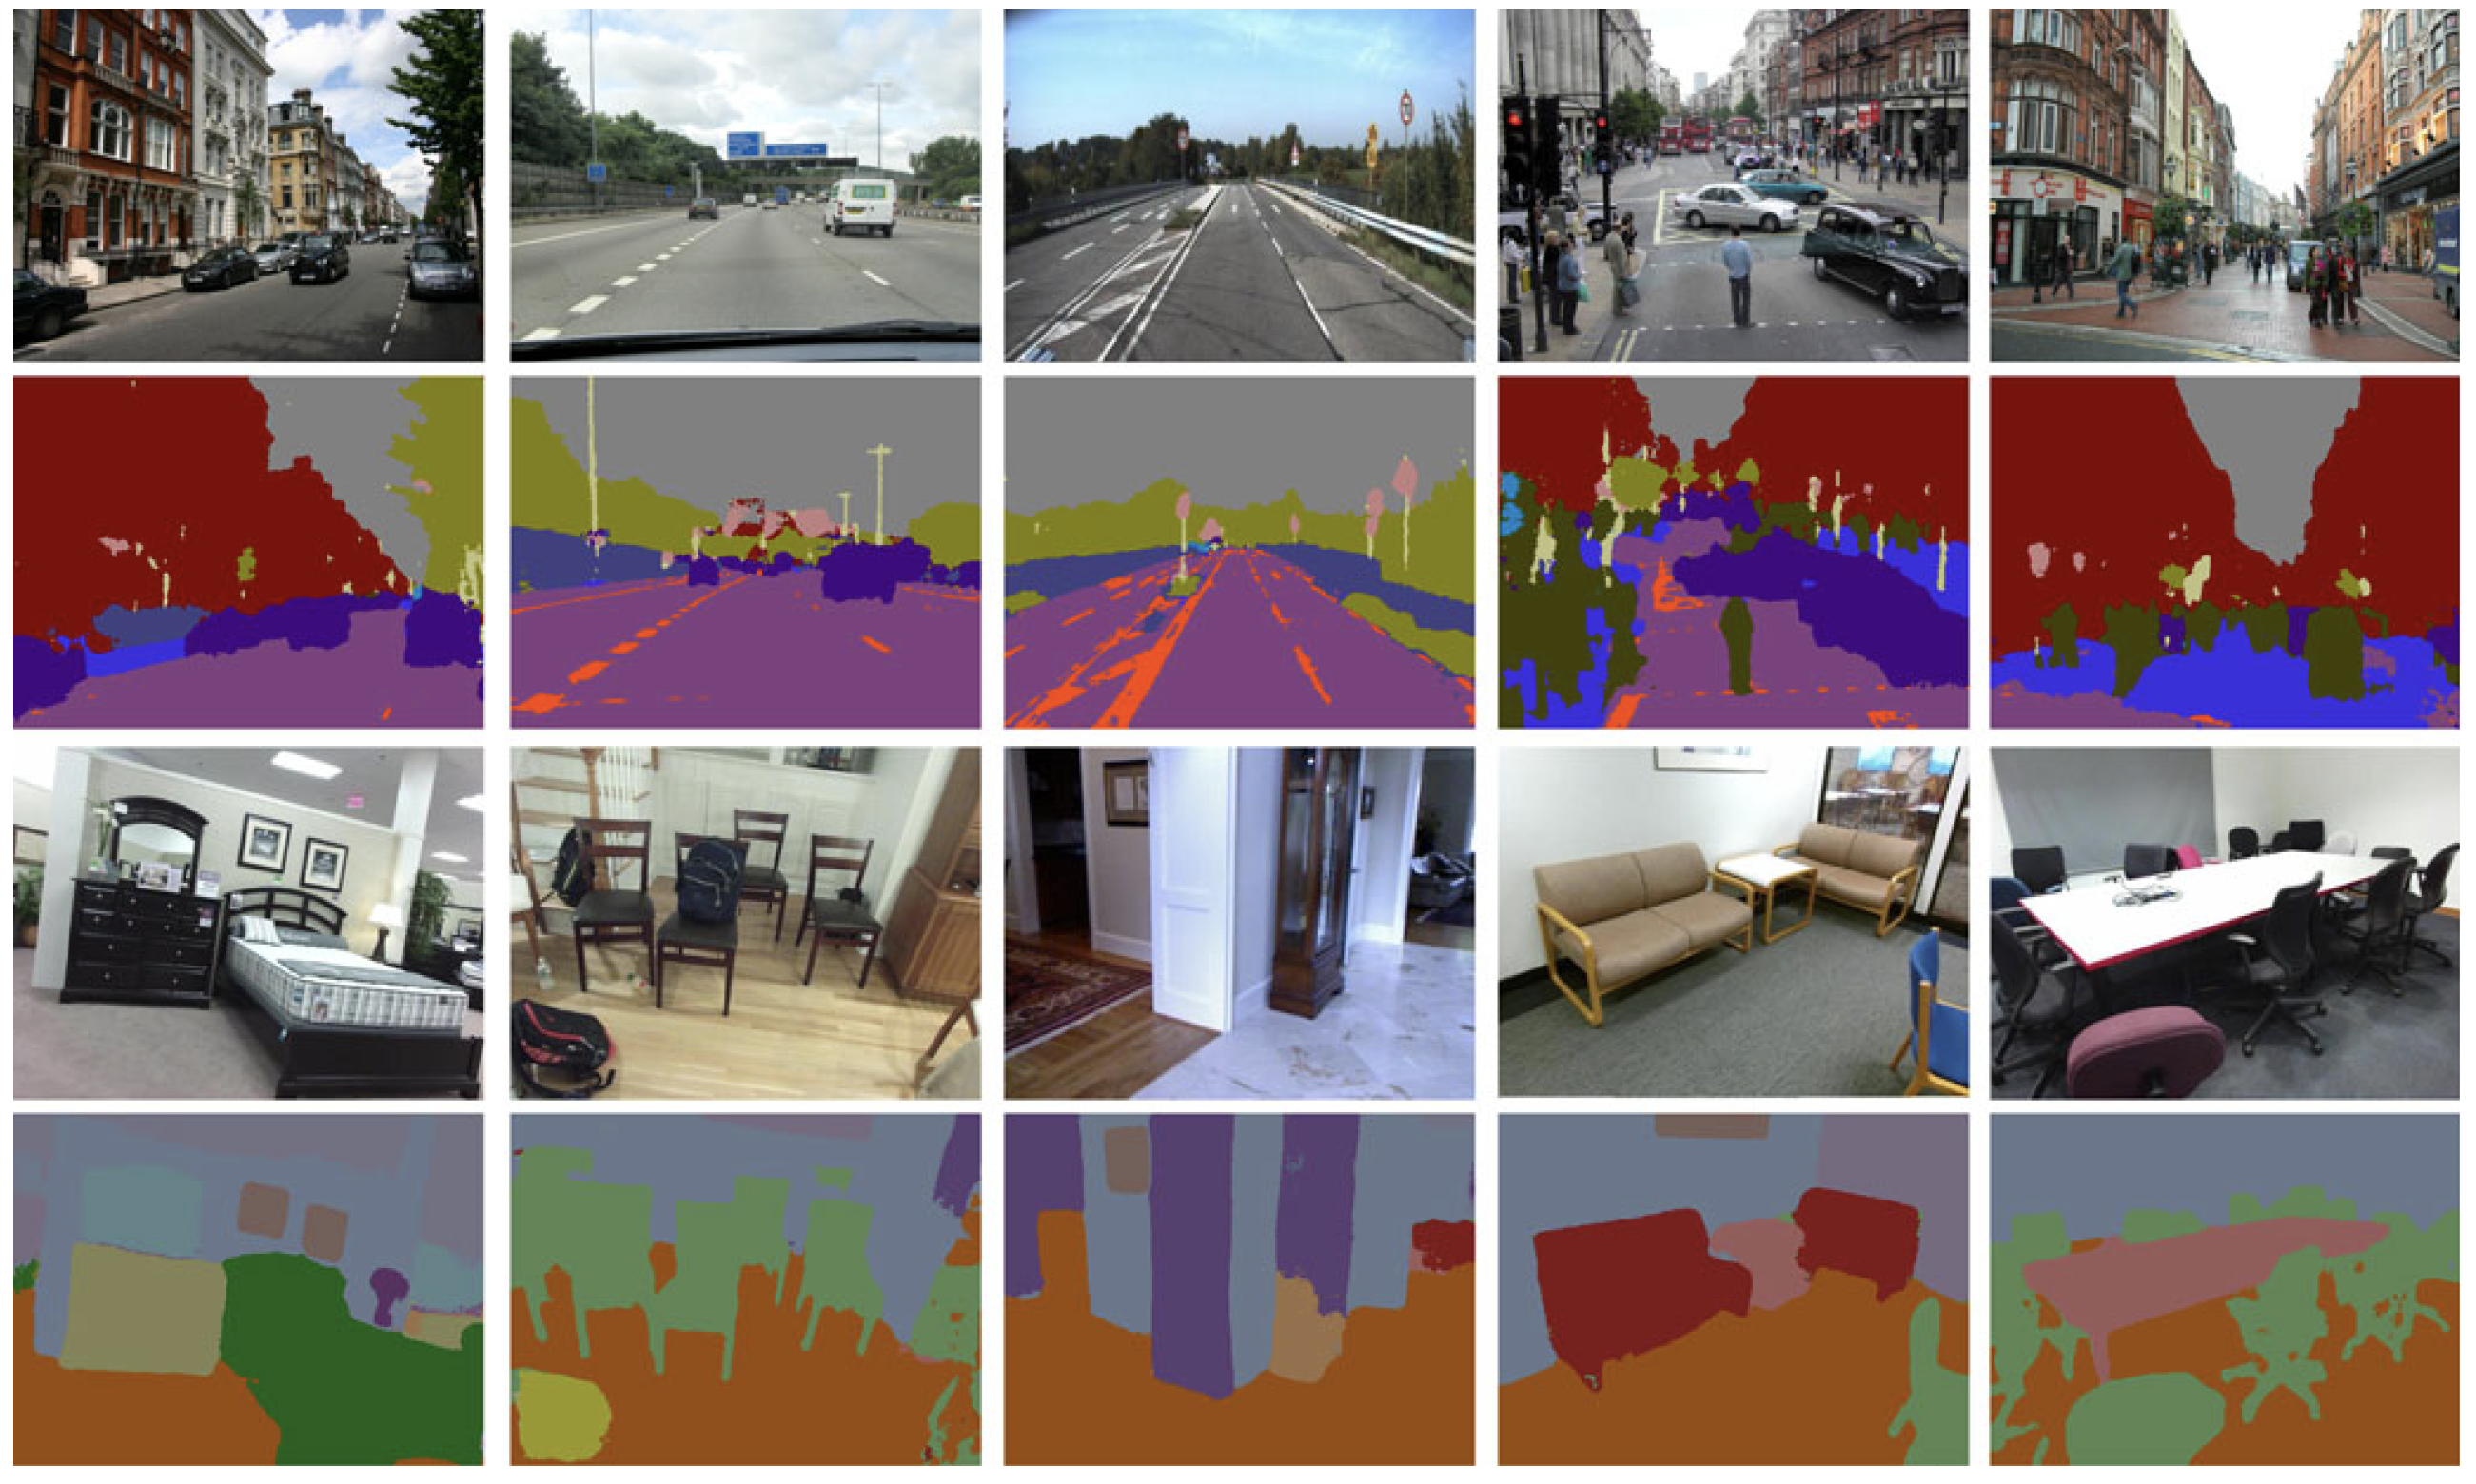
SegNet

Slide 30
Segments data into scenes:
Objects
Background
Etc.
Applications:
Scene understanding
Self-driving cars (what is a road vs tree)
Uses VGG16 layers in encoder for pre-training

Slide 31
Why this can be useful
Autoencoding is found to be useful in a range of data, including languages
Google Translate works by encoding language into a vector, then decoding it as another vector
No need to learn complicated stuff like verb tense, etc.
Translation, however, serves many purposes
Given initial steps of a simulation, use autoencoder to skip steps -> find final simulation image/data
Dramatic speed up in simulations!
Stenography: hiding one image in another (see: Rehman et al., “End-to-End Trained CNN Encoder-Decoder Networks For Image Steganography” (2018)

Slide 32
Conclusion
You have many knobs to turn: have fun with them!
Dropout
Batch normalization
Other hyperparameters: layers, neurons, activation (e.g., ReLU), CNN vs Dense,…
All this work is extremely new
Many papers I’m citing are ca. 2019-2020
Therefore, keep up with literature!
You might find a paper that massively simplifies your problem with free code for Python no less!
Knowledge is power:
Neural networks are like glass vases: beautiful but fragile
Take any claim about AI snake oil with a large grain of salt

